Slide 1

Mathematical Modelling and

Slide 2
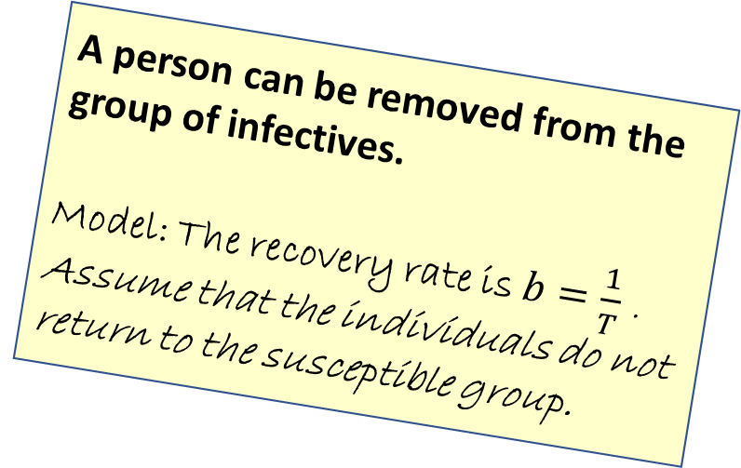
Modelling assumptions
An individual is infectious for a fixed number of days.
Model: the infectious period is T days
In our final model, we consider a third compartment.
This allows individuals to move out of the infectives group.
A person can be removed from the group of infectives.
Model: The recovery rate is $b=\frac{1}{T}$ . Assume that the individuals do not return to the susceptible group.
Use a further compartment
Consider how fast the group of infectives is growing.

Slide 3
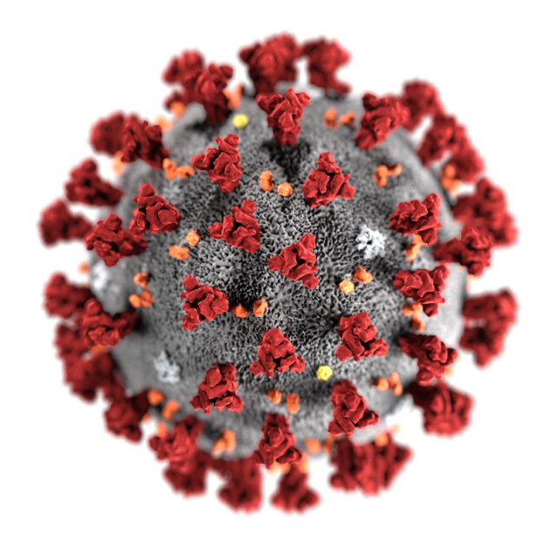



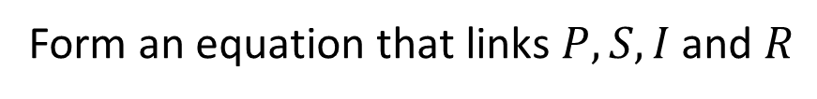


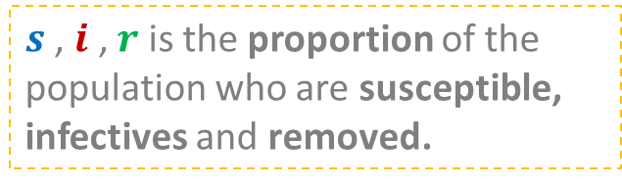

An improved compartmental model
The whole population, $P$, is divided into:
Susceptibles, S
Infectives, I
Removed, R
Form an equation that links $P, S,I$ and $R$
$$P=S+I+R$$
Or we can form the equation:
$$s+i+r=1$$
$s$ , $i$ , $r$ is the proportion of the population who are susceptible,
infectives and removed.

Slide 4
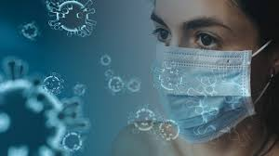

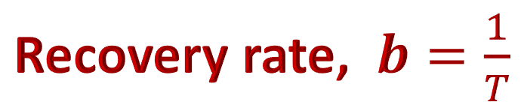

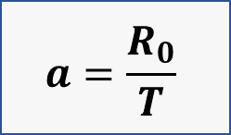






Recovery rate, $b=\frac{1}{T}$
$$s+i=1$$
$$a=\frac{R_{0}}{T}$$
$$s$$
$$i$$
$$r$$
An individual moves from $s$to $i$
An individual moves from $i$ to $r$
COVID-19
$$T=7$$
$$R_{0}=2$$

Slide 5
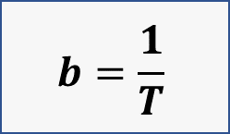
Rates of change
$$s+i=1$$
$$a=\frac{R_{0}}{T}$$
$$s$$
$$i$$
$$r$$
$$b=\frac{1}{T}$$
To understand the spread of this disease, we want to know how fast the group of Infectives is growing.
Introduce derivatives.

Slide 6
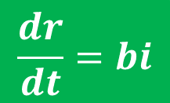

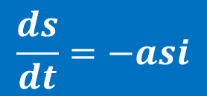
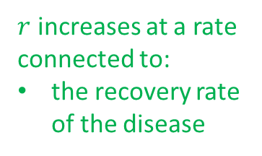
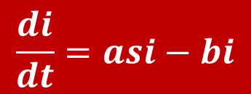
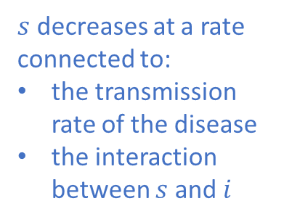

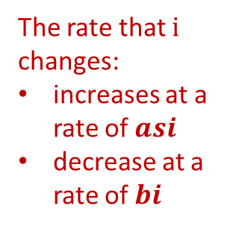
Rates of change
$$s+i+r=1$$
$$a=\frac{R_{0}}{T}$$
$$s$$
$$i$$
$$r$$
$$b=\frac{1}{T}$$
$s$ decreases at a rate connected to:
the transmission rate of the disease
the interaction between $s$ and $i$
The rate that $i$ changes:
increases at a rate of $asi$
decrease at a rate of $bi$
$r$ increases at a rate connected to:
the recovery rate of the disease
$$\frac{ds}{dt}=−asi$$
$$\frac{di}{dt}=asi−bi$$
$$\frac{dr}{dt}=bi$$

Slide 7




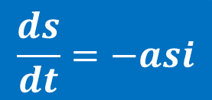
$$s$$
$$i$$
$$r$$
$$\frac{ds}{dt}=−asi$$
$$\frac{di}{dt}=asi−bi$$
$$\frac{dr}{dt}=bi$$
A level Maths does not equip us to solve these differential equations.
A numerical process is used beyond the scope of our course.
We can input the gradient functions into a graph plotter.

Slide 8

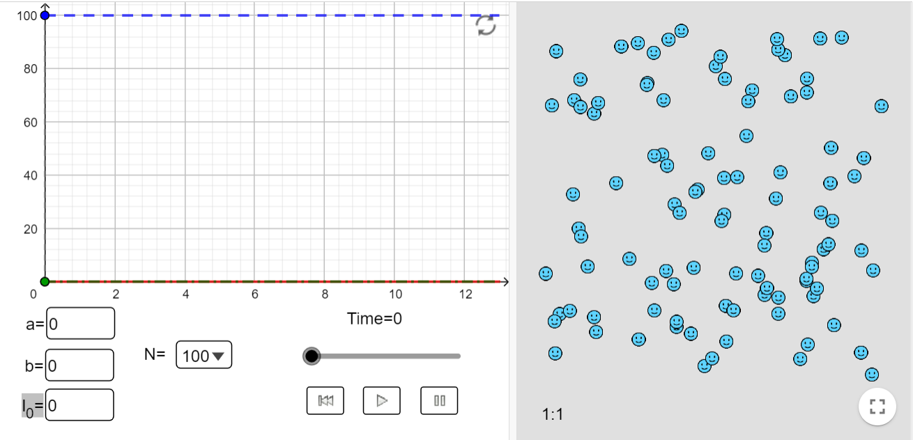

Explore the S-I-R curves
Generate the curves for your derivatives.
Learn how to input the derivative functions.
Look at how the peak can be delayed and reduced.

Slide 9
Modelling assumptions
With a third compartment, the curve of infectives resembles the characteristic curve for the spread of an infectious disease.
What further considerations could we take into account?
Transmission rates may vary for different subgroups.
Model: have curves for age, gender, ethnicity, …
Incubation period.
Model: consider individuals who have been exposed to an infection but are not yet infectious.
Also consider:
Natural immunity,
Herd immunity
The impact of a vaccine

Slide 10


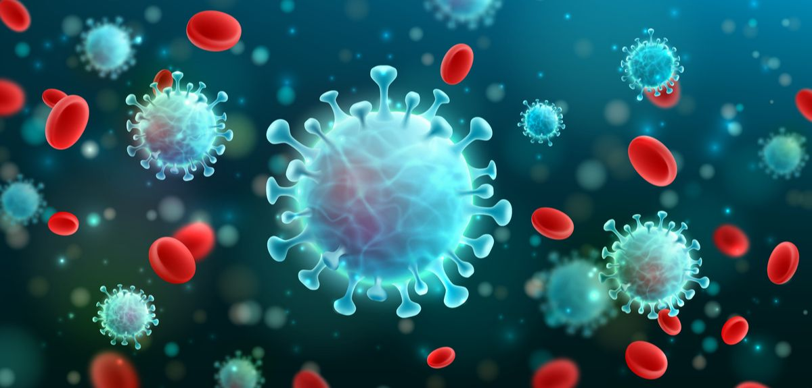
Independent tasks

Slide 11
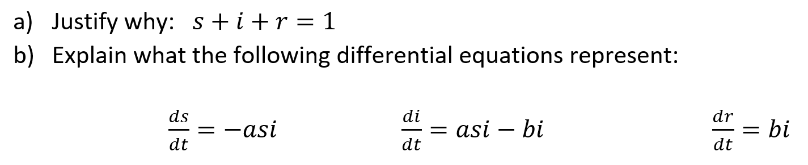
The $s−i−r$ compartmental model

Slide 12
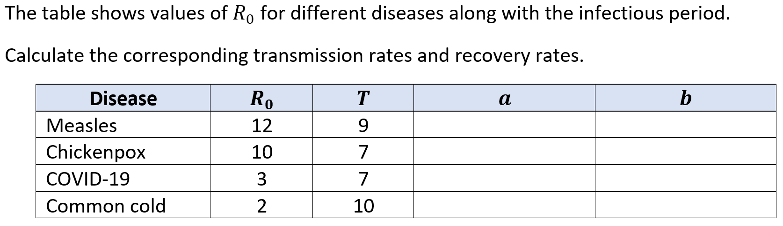
Discuss: transmission & recovery rates

Slide 13
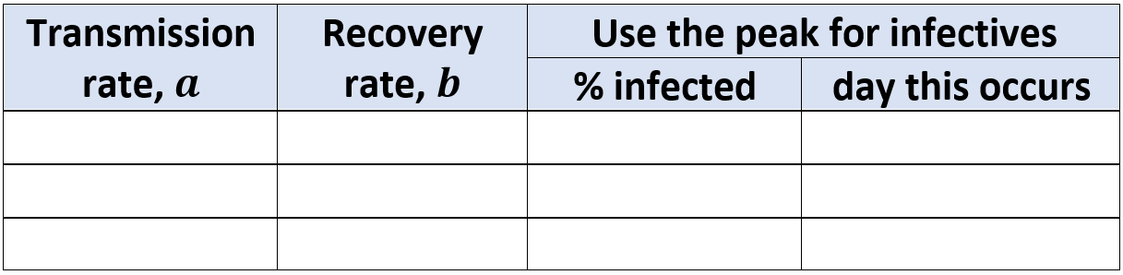
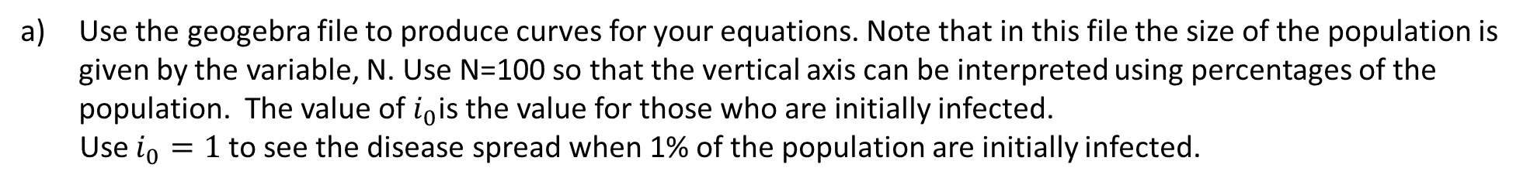

Explore: use values for $a$ and $b$ to form differential equations for a disease.
$\frac{ds}{dt}=−asi$ $\frac{di}{dt}=asi−bi$ $\frac{dr}{dt}=bi$
Use the geogebra file to produce curves for your equations. Note that in this file the size of the population is given by the variable, N. Use N=100 so that the vertical axis can be interpreted using percentages of the population. The value of $i_{0}$is the value for those who are initially infected.
Use $i_{0}=1$ to see the disease spread when 1% of the population are initially infected.
b) Use your curves to make observations such as:
  the maximum proportion of the population who are infected at one time.
  how long it takes for the whole population to be infected.
c) Compare the peak of the infective curve for different
transmission rates.
List intervention measures that could take place and give reasons why a community may want to flatten
the curve by reducing and delaying the peak

Slide 14
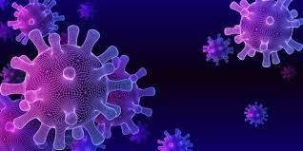
Ideas to explore further

Slide 15



Have a look at how academic institutes have responded to COVID-19
Other areas to investigate
How do tech giants use mobile phone data to monitor movement and R values?
How does the study of mathematical sociology help to understand social interactions and the spread of diseases? How far can we get with computer simulation and artificial intelligence?

